Slide 1
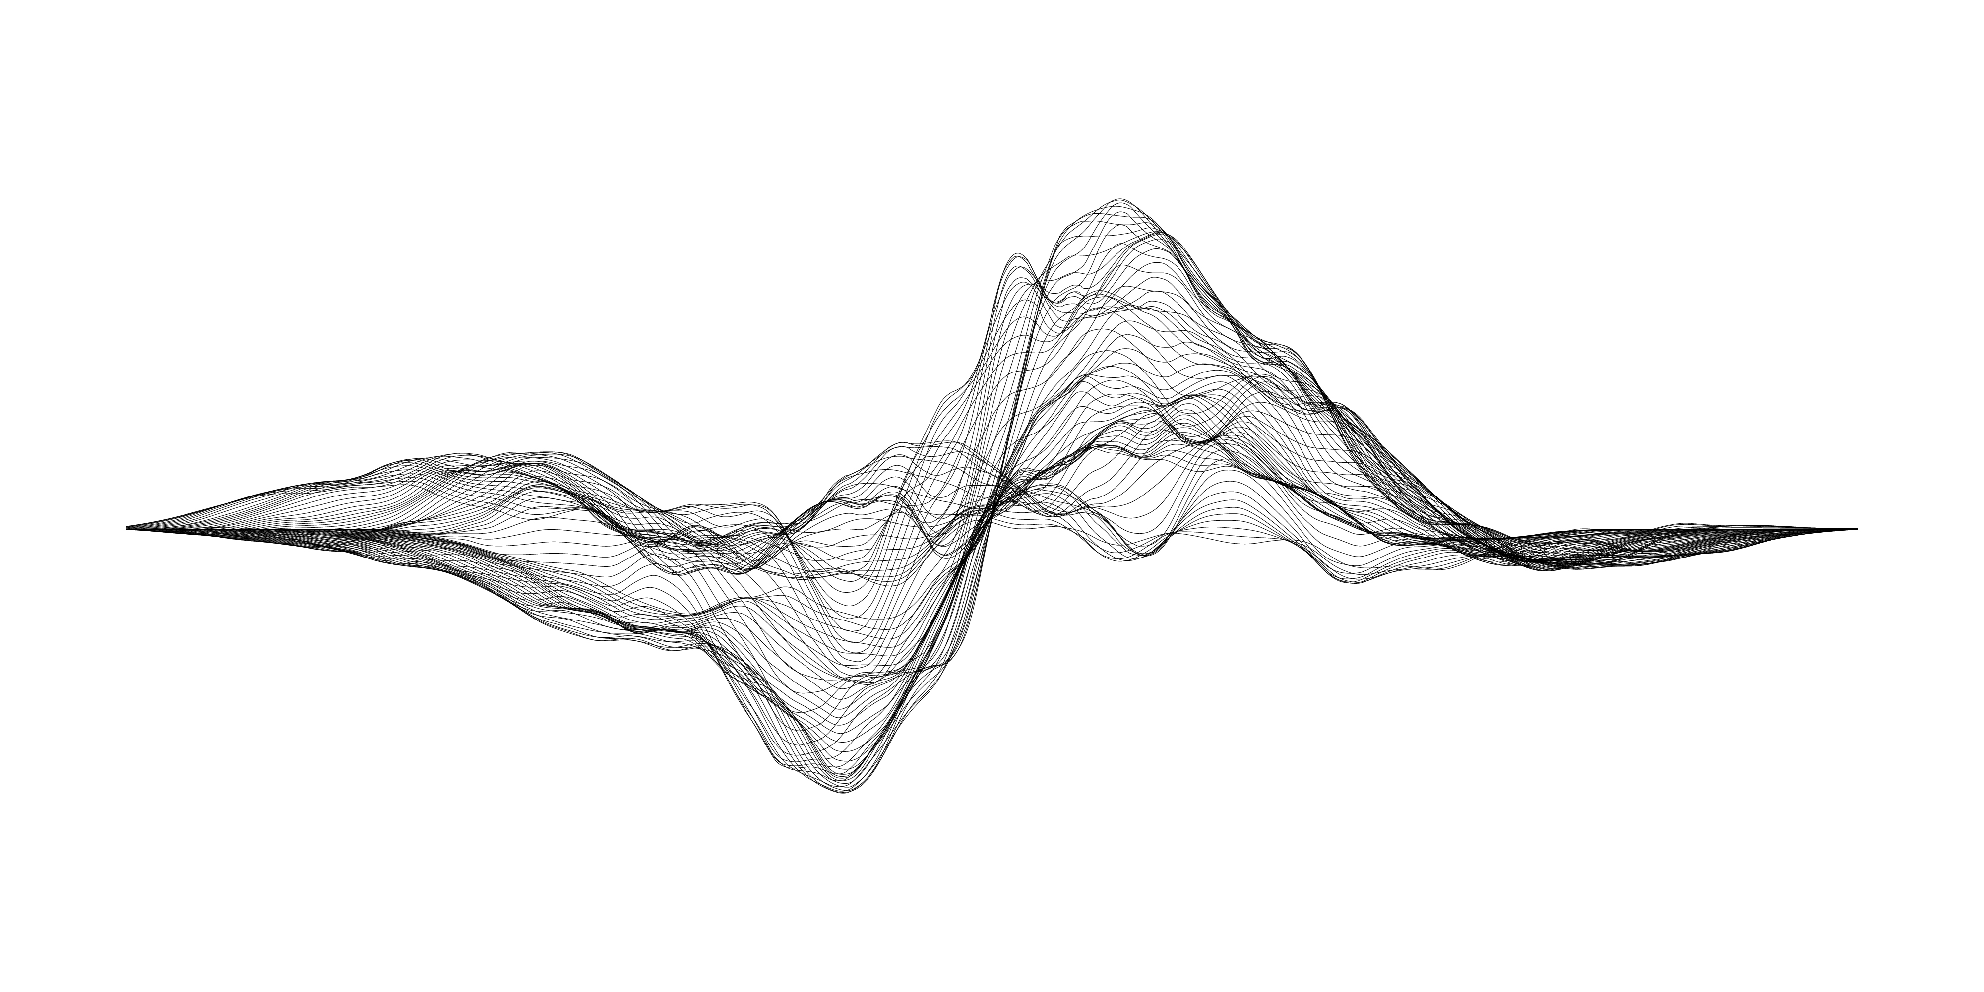

Text Classification
with Python

Slide 2
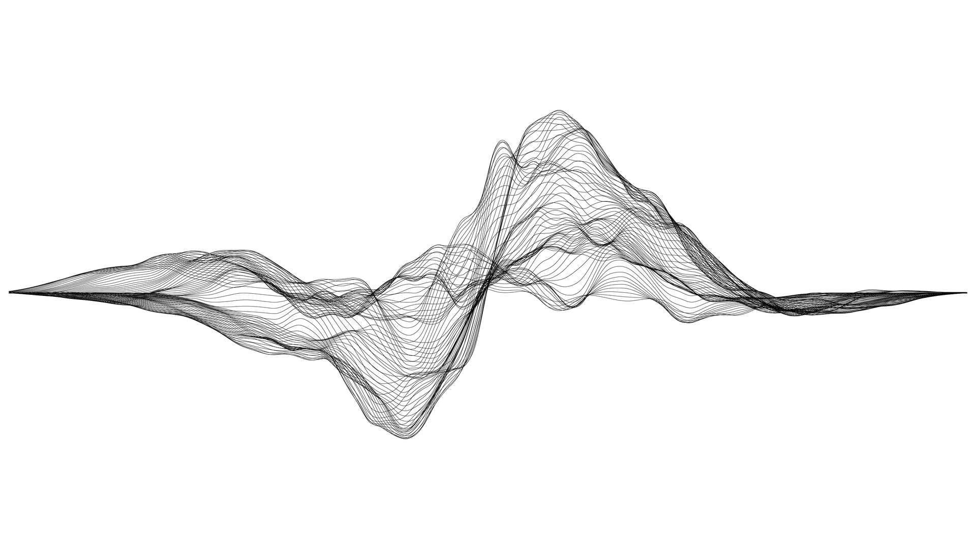
Abdullah Şamil Güser
Senior AI Research Engineer

Slide 3
Sunum Akışı
Metin sınıflandırma probleminin tanımlanması
Sınıflandırma yöntemleri
Python uygulamaları
Sorular & Sonuç

Slide 4
Uygulama Alanları
Sentiment Analysis
Topic Labeling
Language Detection
Intent Detection
Social Media Monitoring
Brand Monitoring
Customer Service
Voice of Customer

Slide 5
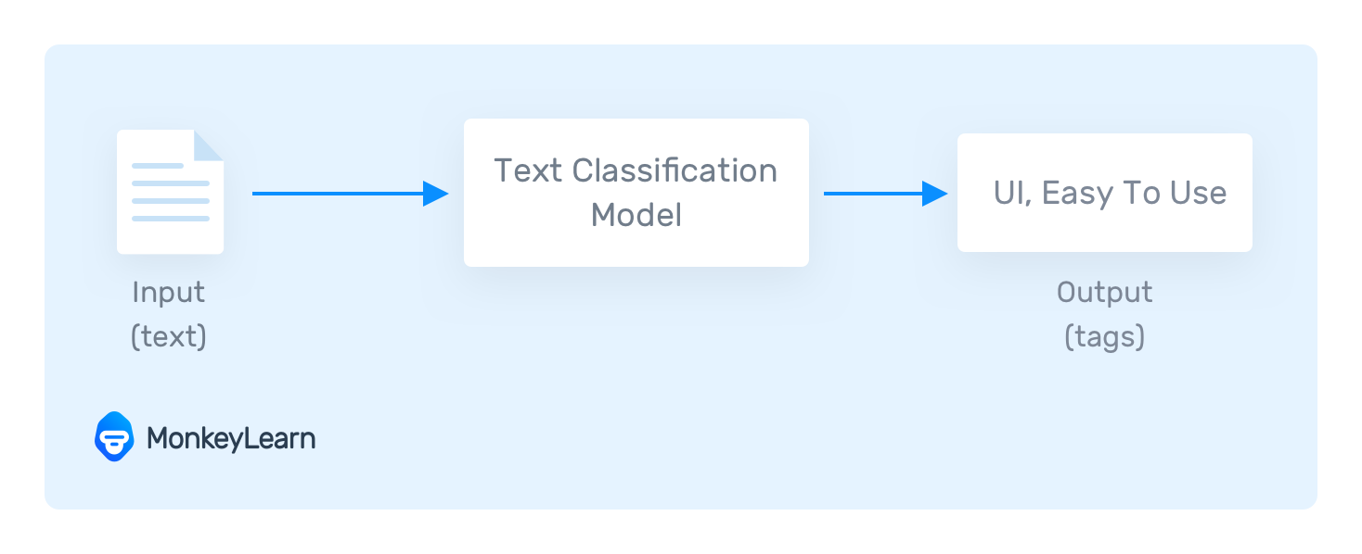
Tanım

Slide 6
Metin Sınıflandırma Türleri
Kural Tabanlı
Makine Öğrenmesi Tabanlı

Slide 7
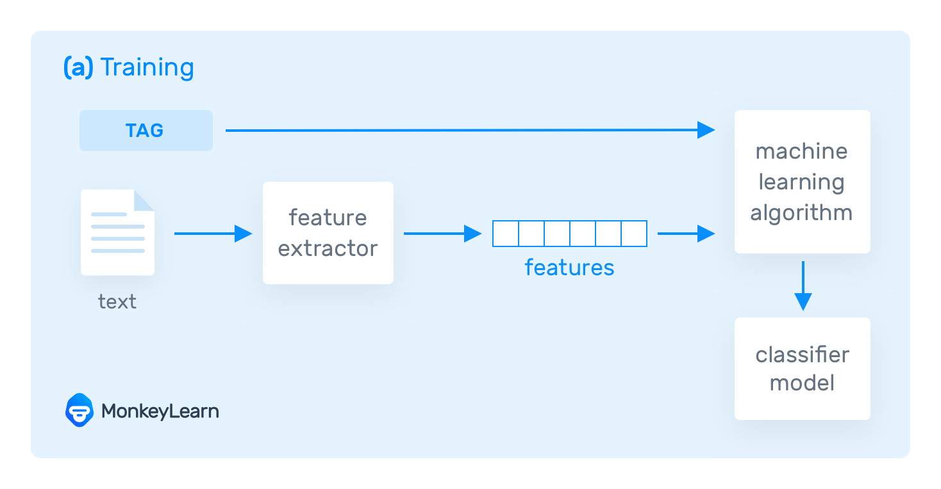
Makine Öğrenmesi Tabanlı Metin Sınıflandırma

Slide 8
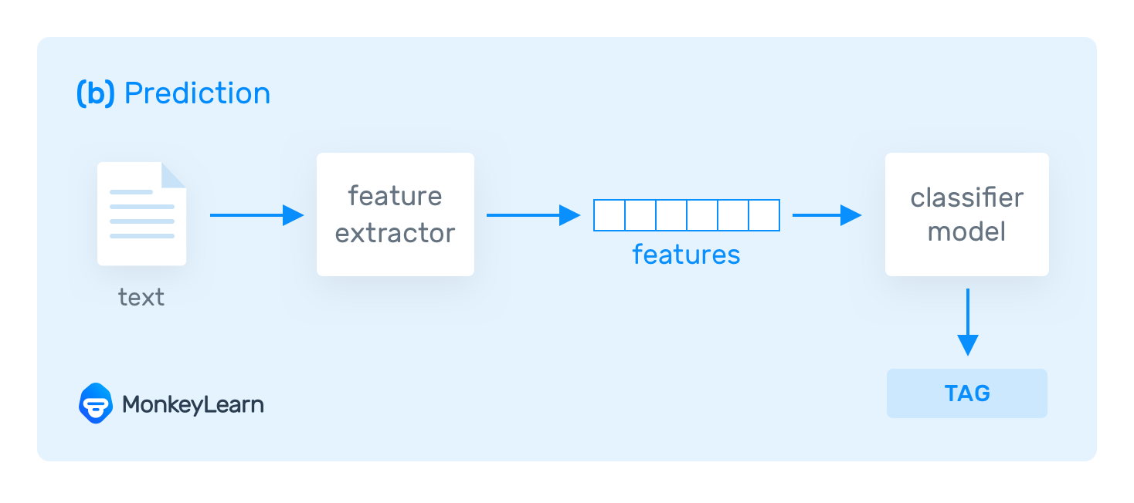
Makine Öğrenmesi Tabanlı Metin Sınıflandırma

Slide 9
Performans Ölçümü
Accuracy: The percentage of texts that were categorized with the correct tag.
Precision: The percentage of examples the classifier got right out of the total number of examples that it predicted for a given tag.
Recall: The percentage of examples the classifier predicted for a given tag out of the total number of examples it should have predicted for that given tag.
F1 Score: The harmonic mean of precision and recall.

Slide 10
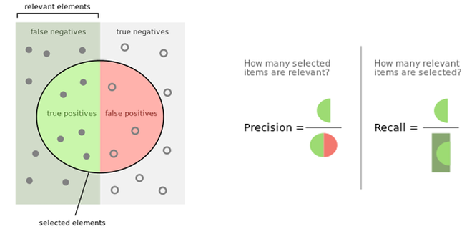
Performans Ölçümü

Slide 11
Metin Sınıflandırma Yöntemleri
Naive Bayes
Logistic Regression
K-Nearest Neighbor (KNN)
Support Vector Machines
Neural Networks

Slide 12
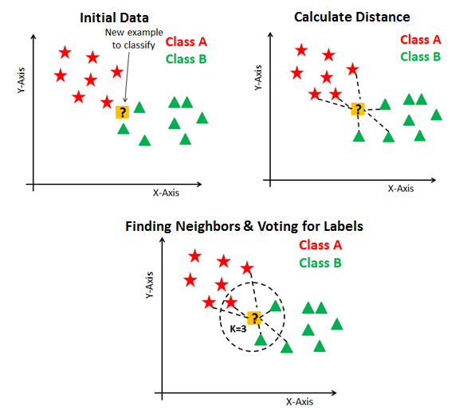
K-Nearest Neighbor (KNN)

Slide 13
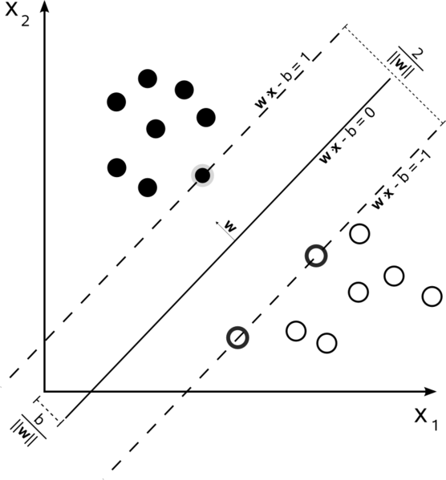
Support Vector Machines (SVM)

Slide 14
Referanslar
https://monkeylearn.com/text-classification/
https://res.cloudinary.com/dyd911kmh/image/upload/f_auto,q_auto:best/v1531424125/KNN_final1_ibdm8a.png
https://i.stack.imgur.com/bANZI.png
https://github.com/gsamil/algorithms
https://miro.medium.com/max/2400/1*Ub0nZTXYT8MxLzrz0P7jPA.png

Slide 15

Teşekkürler
sestek.com

